Slide 1
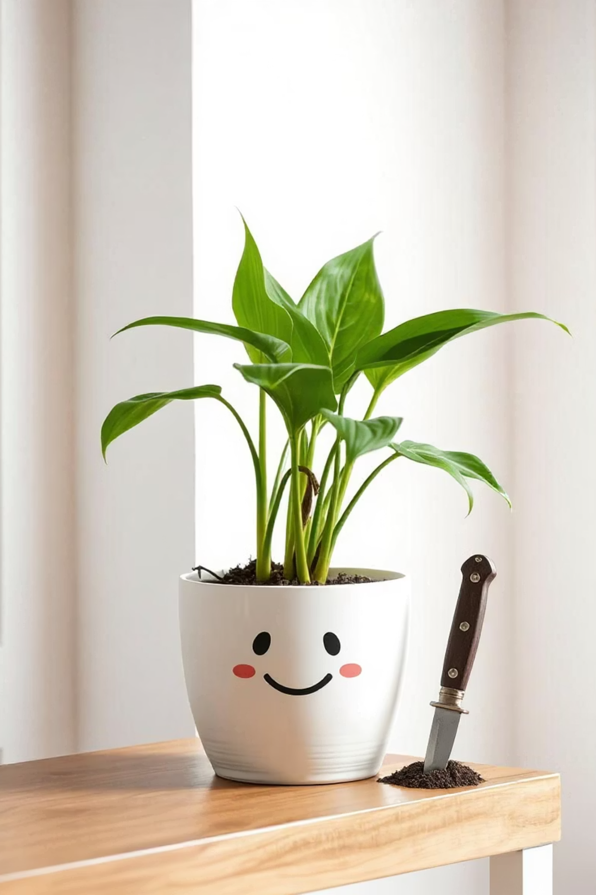
Green Stab!

Slide 2
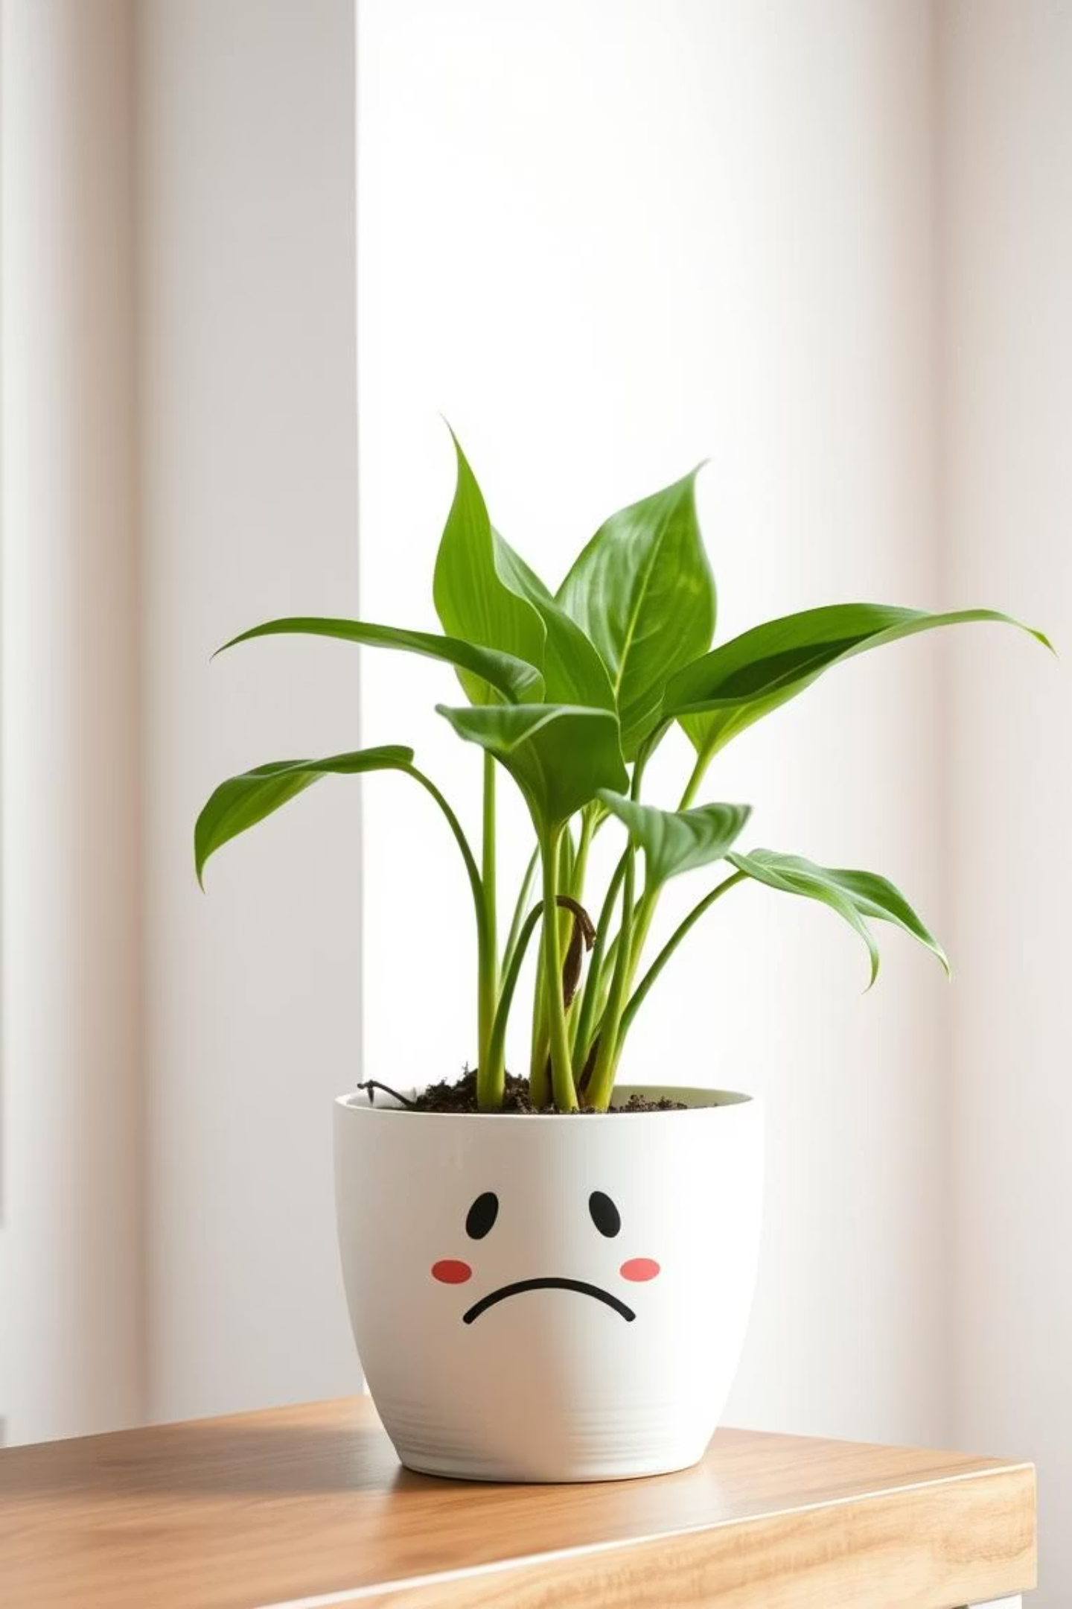
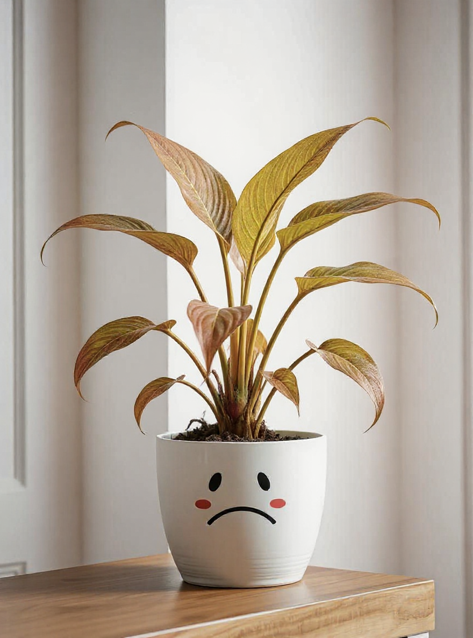


The Problem
- Plant Care Failures
Lack of Knowledge
Uncertainty about optimal condition
Unconsistent of management
Too Broad Information
No device for personal environment
No reflection on real-time data

Slide 3
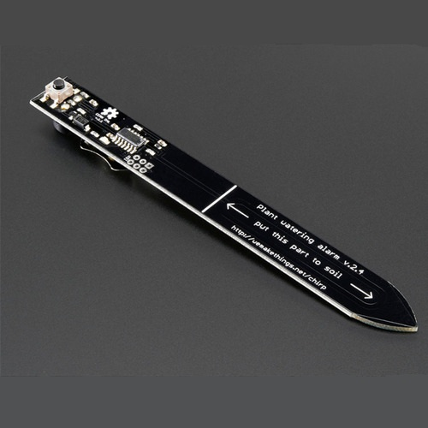
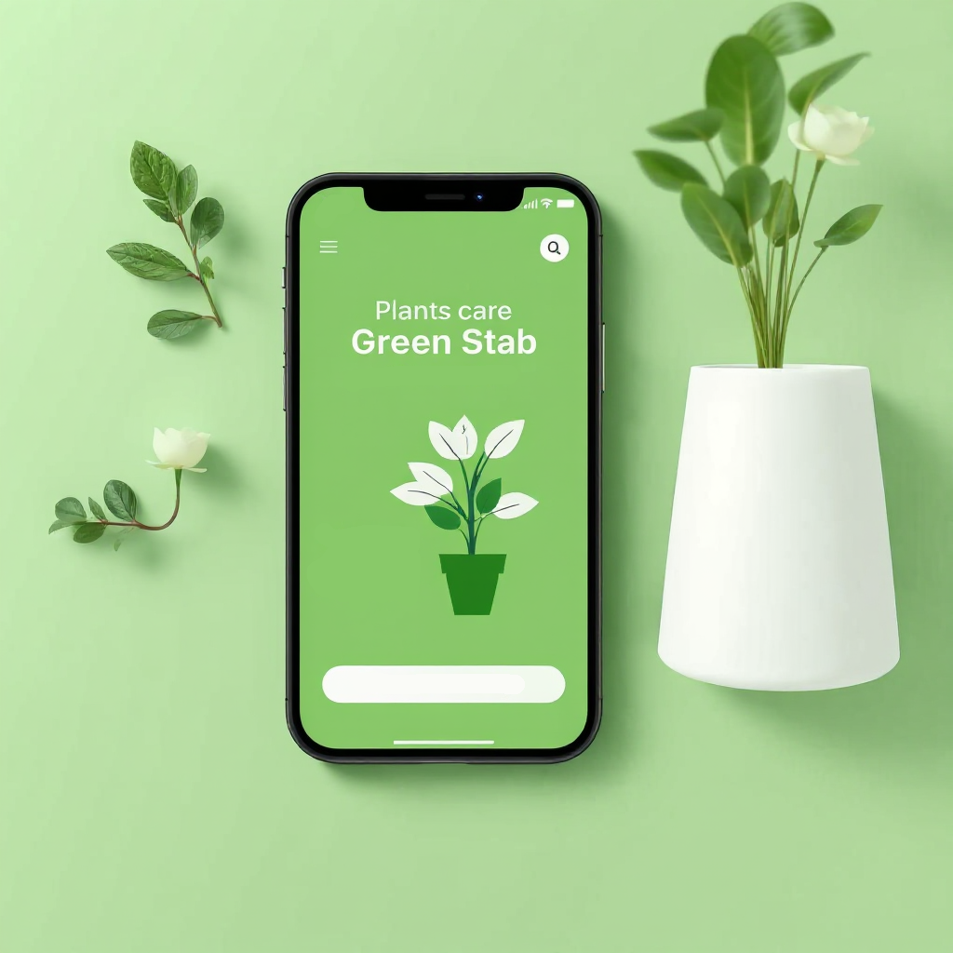
Solution - IoT Device & App
IoT Device
Mobile App
Measures temperature, humidity, and light
AI-based planting advice
Minimized configuration for COGS savings
Notifications based on Individual
Easy-to-use UX/UI

Slide 4
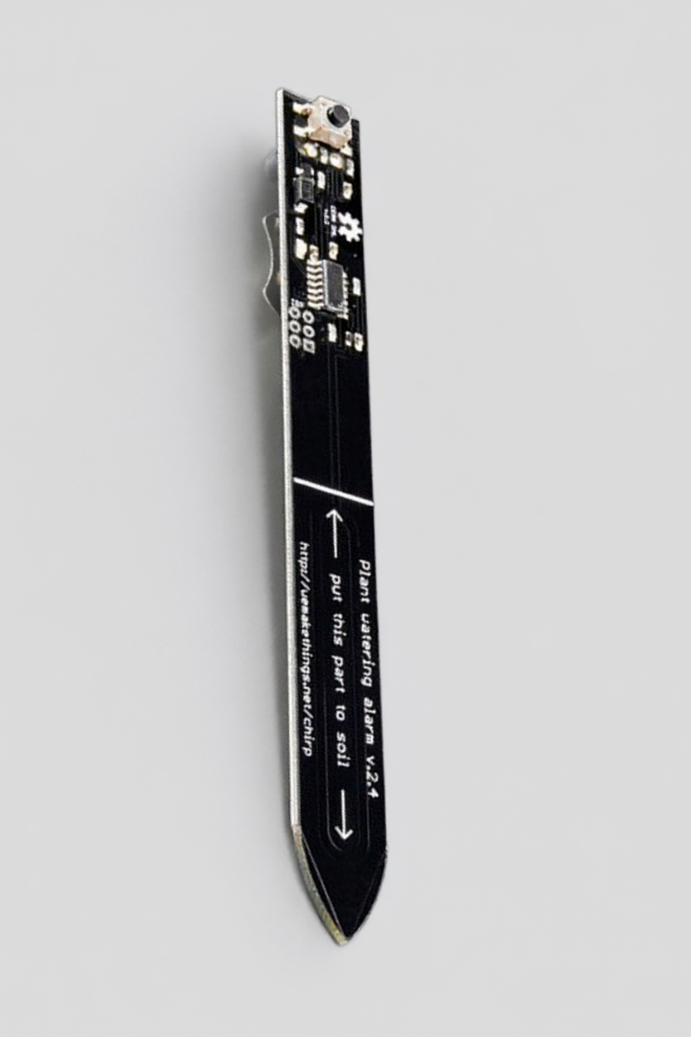
Competitive Edge
 | Beginner Friendly | Personalized Advice | Automatic Alerts | Portability | Device Price
Green Stab | O | O | O | O | 15$
Greg (App) | X | O | X | O | -
Click & Grow (Smart Pot) | O | O | O | X | 99$
Xiaomi (Smart Pot) | O | O | O | X | 55$
Chirp (Embedded Sensor) | X | X | O | O | 18$

Slide 5



Why Now?
- Market Trends & Opportunity
Interior Trends
IoT & AI
DIY & Contactless
Surging demand for indoor gardening
driven by home interior trends.
The global home gardening market Growth USD 14.90 billion - 2024 USD 15.78 billion - 2025, 5.92% CAGR through 2034
https://www.custommarketinsights.com/press-releases/home-gardening-market-size/
Widespread availability of IoT sensors
and AI for remote plant care.
Aligns with the rise of contactless
and DIY leisure activities.

Slide 6

Market Opportunity Overview
 | Definition | Market Size (USD) | Rationale and Assumptions
TAM | Global Home Gardening | 15.78 Billion | 2025 global home gardening market valuation https://www.custommarketinsights.com/report/home-gardening-market/
SAM | Global Smart Indoor Gardening System Market | 2.90 Billion | 2025 smart indoor gardening systems market size https://www.datainsightsmarket.com/reports/indoor-self-growing-garden-1372849
SOM | Asia-Pacific Smart Indoor Gardening Market | 0.87 Billion | 30% of SAM based on regional market share → 0.30 × 2.90 Billion https://www.zionmarketresearch.com/report/gardening-market
LAM | Korean Initial User Target Market | 0.087 Billion | 10% of SOM for initial market penetration → 0.10 × 0.87 Billion https://www.linkedin.com/pulse/south-korea-smart-garden-system-market-2026-size-trends-key-yijnc/

Slide 7
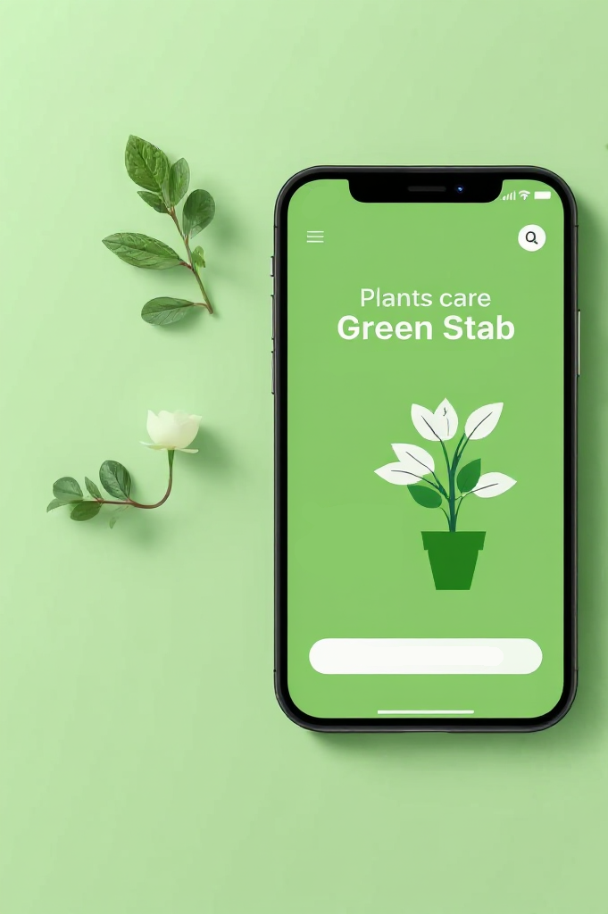
Business Model
Subscription
Free Version
- Require Device ($15)
- Mornitor real-time date
Payment Version
- Free Version + Advice + Alert
- $3/month - 6 month subscription (+ free device)
Premiem Version
- Payment Version + More question chance
- 5$/month

Slide 8
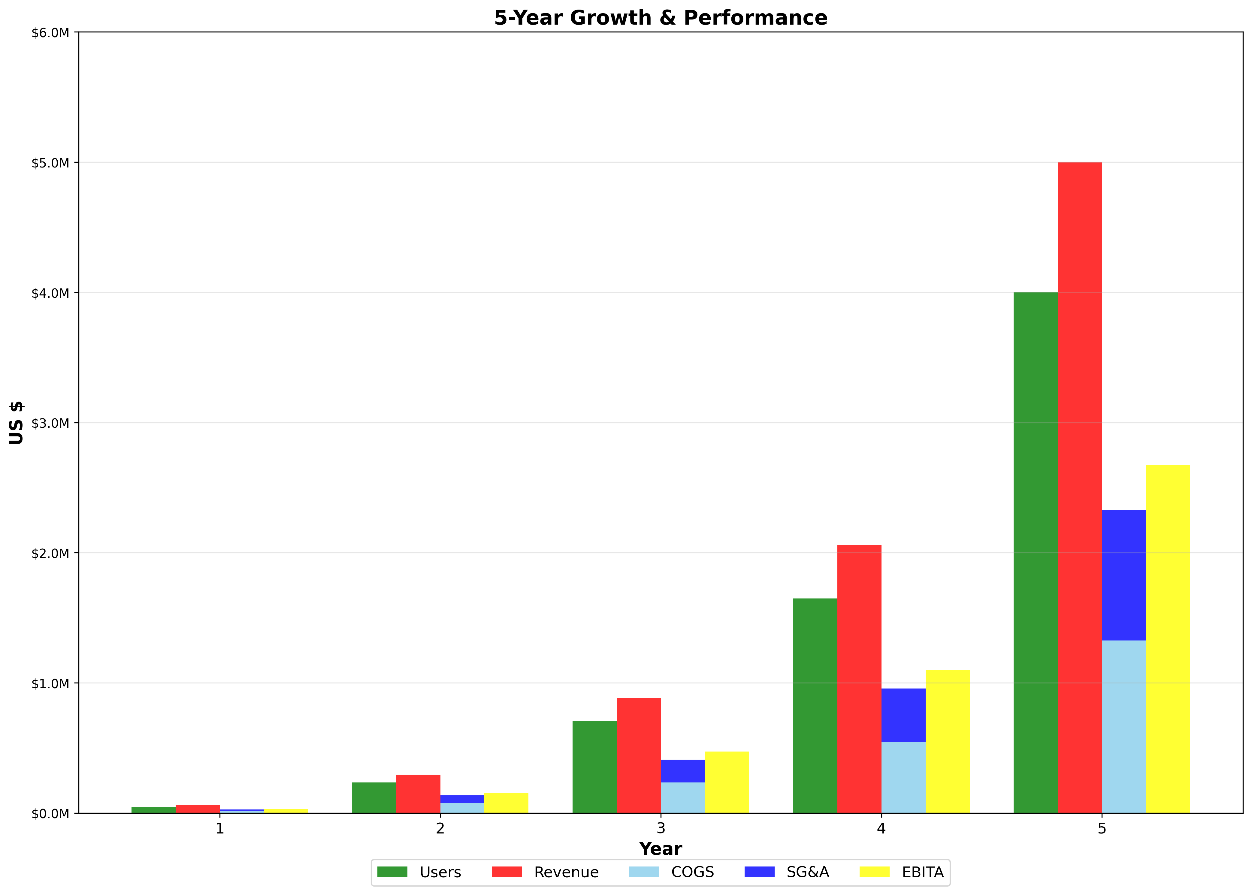
Financial
Outlook
 | Year 1 | Year 2 | Year 3 | Year 4 | Year 5
Users | 1,000 | 5,000 | 15,000 | 35,000 | 85,000
Revenue | 58,800 $ | 294,000 $ | 882,000 $ | 2,058,000 $ | 4,998,000 $
COGS | 15,600 $ | 78,000 $ | 234,000 $ | 546,000 $ | 1,326,000 $
SG&A | 11,760 $ | 56,800 $ | 176,400 $ | 411,600 $ | 999,600 $
EBITA | 31,440 $ | 157,200 $ | 471,600 $ | 1,100,400 $ | 2,672,400 $
Notes:
Revenue: 매출 COGS: Cost of Goods Sold(매출원가) SG&A: Selling, General and Administrative Expenses(판매 및 일반관리비) EBITA: Earnings Before Interest, Taxes and Amortization(이자, 세금, 감가상각 전 이익

Slide 9
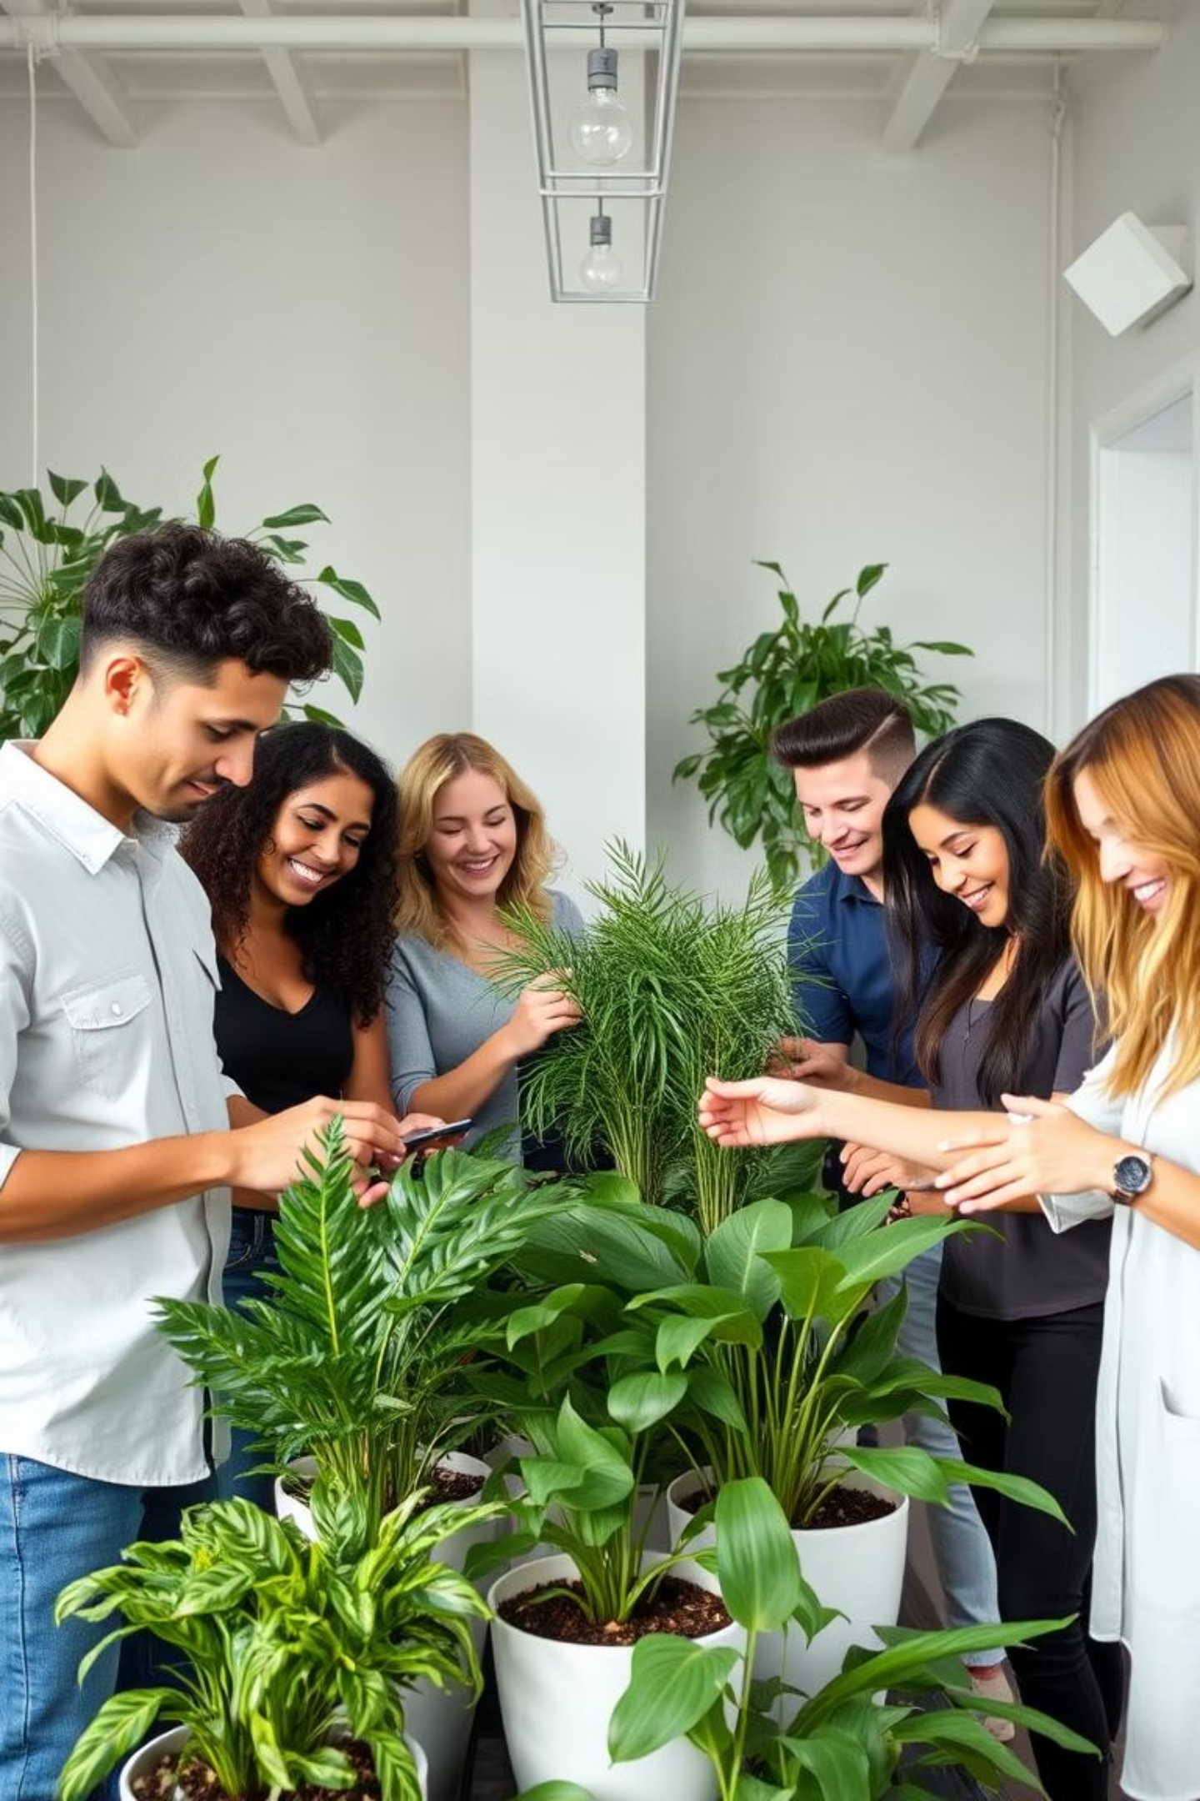
Our Vision:
Empowering Green Start
Empower everyone to successfully grow plants at home,
experiencing daily healing and a sustainable lifestyle.
The Ask:
Investment: $200K seed round for IoT, AI development, and marketing.
Partnership: Collaboration with gardening communities and brands.
Recruitment: Programmers for App/DB/AI (Embeded is Okay. I am.)

Slide 10
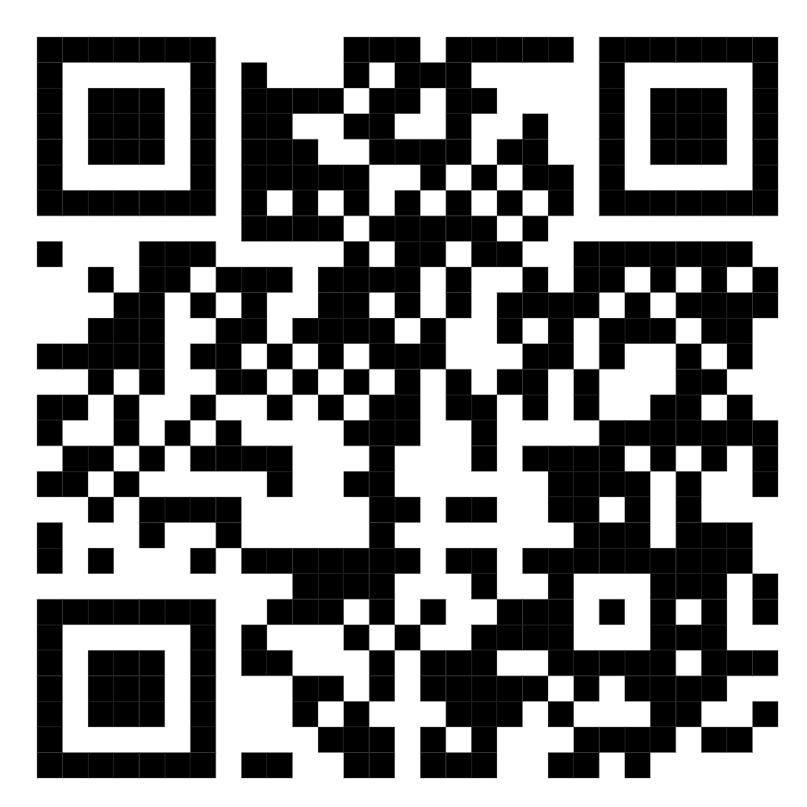
~Thank You~
Green Stab!
LinkedIn
Name: Baek SangHo
Mail: qqqqmmss11@gmail.com
Github: BigCodult
LinkedIn: sangho baek

